Slide 1
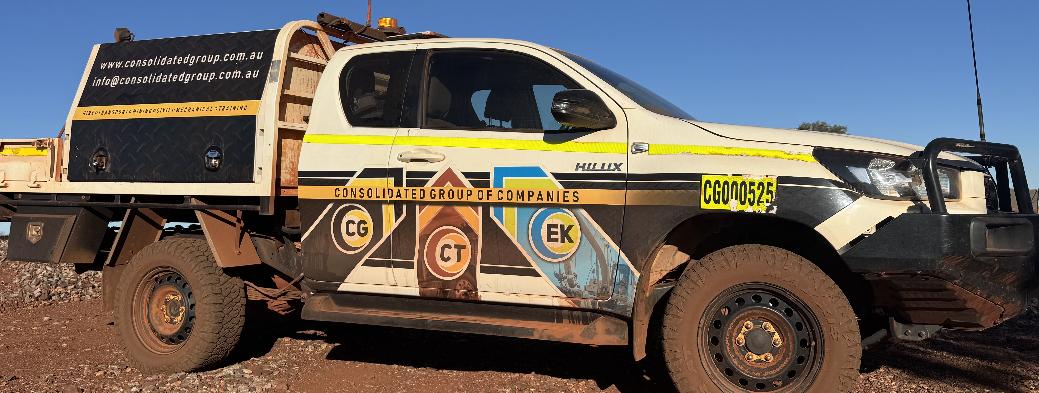









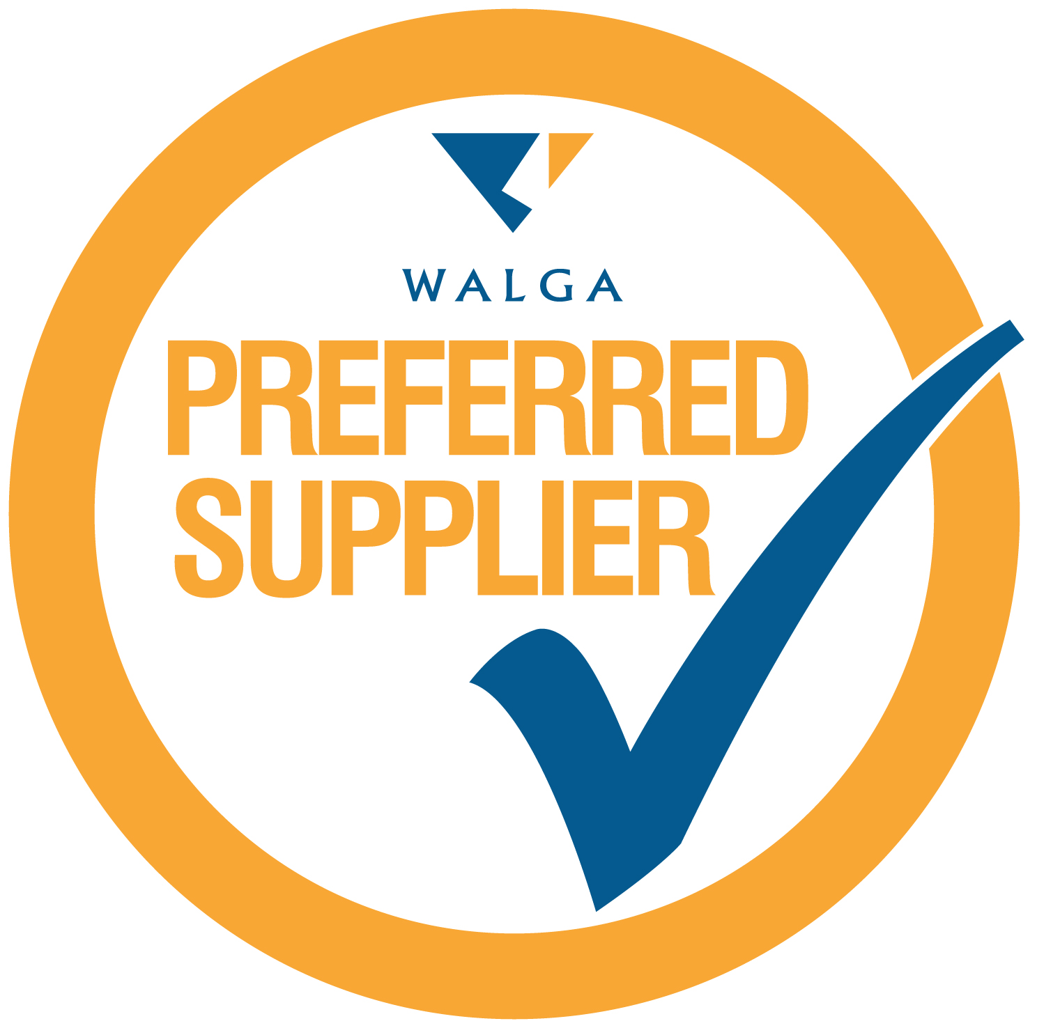





DEFENCE CAPABILITY
QUAD CHART · 2026
Traditional Nyamal owned & operated · Majority Indigenous owned
EK Contracting Pty Ltd T/A Jakarli Group Services
CORE CAPABILITY
COMPANY INFORMATION
Current at Aug 2026
Civil, transport, plant and mechanical services for Defence bases, ranges and training areas — mobilised from Perth, Bunbury and Port Hedland.
$20m
Annual turnover
50
Employees
2019
Established
No
Currently exporting
Defence Base Services – ranges & training area management, project management
Civil works – earthworks, drainage, cartage, site clearing
Industrial services – King Vac 11000 vacuum excavation
Training – nationally accredited operator training
Heavy haulage – over-dimensional, float services, hot shots
Mobilisation & demobilisation nationwide
Cartage & recovery nationwide
Mechanical – heavy diesel asset management & maintenance
QUALITY CERTIFICATIONS & REGISTRATIONS
ISO 9001 · ISO 45001 · ISO 14001 (QCSE) · Main Roads WA HVA Accreditation · FSC Accreditation · DISP membership application initiated · Supply Nation Certified
DEFENCE VEHICLE & PLANT HIRE, WITH EXPERIENCED OPERATORS
Rollers · Excavators · Skid Steers · Wheel Loaders · Water Carts · Tip Trucks · Graders · Articulated Haul Trucks · Prime Movers · End & Side Tippers · Conveyor Floor & Float Trailers · Screening Units · Light Vehicles · Portable Green Energy Buildings
AWARDS & RECOGNITION
10 WINS · 2021–2025
Consolidated Group of Companies (CG · CTS · JG)
COMPETITIVE DISCRIMINATORS
2025
WA Training Awards – Small Employer of the Year (Winner) · Rockingham Chamber of Commerce – Service Excellence in an Industrial Business (Winner) · Business News 40under40 – Theo Tsorvas · CCFWA finalist – Training Employer, Indigenous Enterprise
Majority Indigenous owned – Traditional Nyamal owned and operated, dedicated to land-based services
Indigenous employment & training – nationally accredited training for every operator, on all plant
Clear communication – a dedicated scheduler keeps projects in scope and issues resolved fast
Safety you can see – our OHS Manager oversees safety via an online system every operator accesses
2024
CCFWA Training Awards finalist – Training Employer of the Year, Indigenous Engagement, Indigenous Enterprise, Apprentice Non-Civil
2023
WA Training Awards – Small Employer of the Year (Winner) · Australian Training Awards – Small Employer of the Year (Silver) · RKCC Business of the Year & Climate Innovation Award (Winner) · CCFWA Cert IV Trainee of the Year – Kate Tsorvas
KEY CUSTOMERS
FMG · BHP · HIO · CPB · Local Government
KEY PARTNERS
JV with Consolidated Group & Consolidated Transport Services
MEMBERSHIPS
ODIS Mentor · Rockingham Chamber of Commerce · CCFWA · VET Alumni · ICN · WALGA Preferred Supplier
2022
CCFWA Safety Program of the Year (Winner) · WHS Foundation Safety Awards – WHS Management SME (Winner) · WA Training Awards & CCFWA finalist
2021
WA Training Awards – Medium Employer of the Year (Winner) · Australian Training Awards finalist · IFAP Indigenous Engagement Award finalist
Kate Tsorvas – Director 0487 337 424 · kate@ekcontracting.com.au · www.jakarligroup.com · 24 Moorambine Street, Port Hedland WA 6721

